Slide 1

Module 2.4: Electronic communication

Slide 2
Contents
Introduction
Email
ISP email vs web-based email
Email addresses
Address book or contacts list
Practical use of email
Activity 1
Other modes of e-communication
Social networking sites
Instant Messaging and Chat applications
Weblog (blog)
Fax to email
Activity 2
Netiquette
Netiquette and social networking
Netiquette and email
Activity 3
Test and improve
Written module activity

Slide 3


INTRODUCTION
E-communication – all forms of electronic communication
Process by which computers and other communication devices are used to exchange messages and/or digital data

Slide 4
EMAIL
Composing, sending and receiving of messages electronically over a network such as the internet
Use email software to type in recipient’s address
Message first goes to email server at own ISP
Message then goes to email server at other person’s ISP
Message is held there until recipient downloads it

Slide 5



EMAIL
ISP email vs web-based email
Web-based email
Accessed using a web browser anywhere where internet access
Must be online to access account
ISP-based email
Set up on local computer or device using appropriate software
Free of charge (might pay for internet access)
Monthly ISP charge plus internet access cost
Can be accessed without being online

Slide 6
EMAIL
Email addresses
Mary.Jones
@ mweb
.co
.za
Domain
UserName
@Service provider
.Type of organisation
.Geographical location

Slide 7
EMAIL
Address book or contacts list
Used to store email addresses
Email addresses added to list manually or automatically, or imported from another application or email system
Other information can be added (e.g. phone numbers)
Mailing list – list of email addresses grouped under a single name

Slide 8
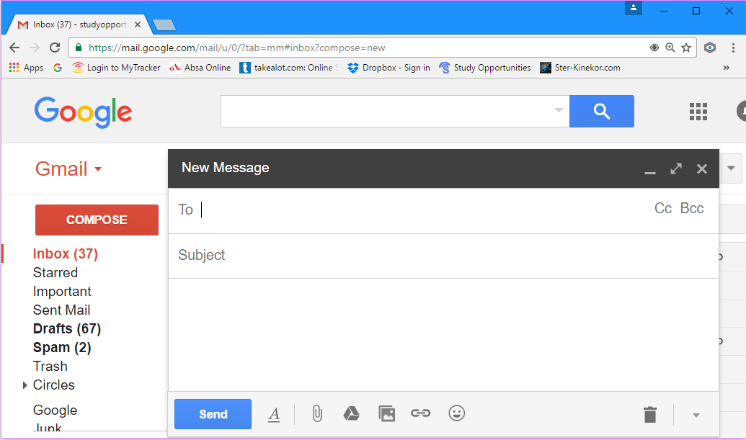
EMAIL
Practical use of email:
Sending, reading, replying and forwarding messages
Sending a message
Click on COMPOSE to create message
To field
Cc and Bcc fields
Subject field
Message area
Click on Send to send message

Slide 9

EMAIL
Practical use of email:
Sending, reading, replying and forwarding messages
Reading a message
Go to Inbox and double-click on message
Unread messages are displayed in bold

Slide 10
EMAIL
Practical use of email:
Sending, reading, replying and forwarding messages
Replying to a message
With message open click on Reply button
To field automatically filled in RE: automatically added to Subject Field
Reply All sends reply to all addresses in To and Cc fields
Original message visible – type your reply above it
Good practice to leave original message – allows recipient to keep track of correspondence

Slide 11
EMAIL
Practical use of email:
Sending, reading, replying and forwarding messages
Forwarding a message
Do not forward chain letters or hoaxes
Click on Forward button FW: automatically added to Subject field
Good practice to delete unnecessary addresses of people who have received the message, before you forward it

Slide 12
EMAIL
Practical use of email:
Attachments
Email applications let you attach files to messages
Program files with extension .exe sometimes not allowed because of virus risks
Limit on size of attachments (Gmail 25 MB) Acceptable max size differs from organization to organization

Slide 13
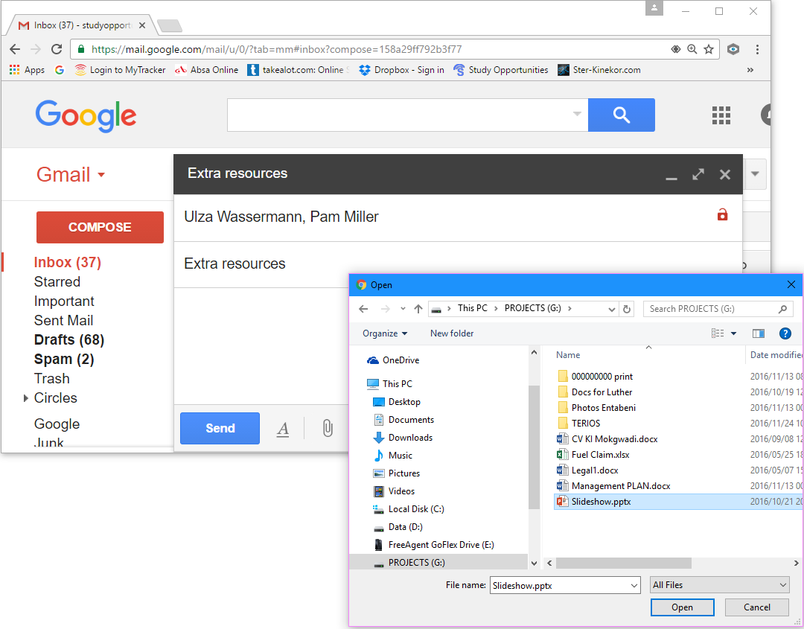
EMAIL
Practical use of email:
Attachments
To attach a file:
Click Attach icon
A dialog box will appear
Locate the file, click Open to attach
Click Send

Slide 14
EMAIL
Practical use of email:
Attachments
To open attachment:
First open message – attachment shown as icon with name of file
Save file to computer, then open file (Can open file without saving it first – file will open in application associated with that type of file)
Do not open attachments in messages from people you do not trust – might contain a virus

Slide 15
ACTIVITY 1

Slide 16





OTHER MODES OF E-COMMUNICATION
Social networking sites
Interactive websites where individuals and organisations post their likes, dislikes, photographs and activities for friends and interested parties to read and respond to

Slide 17





OTHER MODES OF E-COMMUNICATION
Instant Messaging and Chat applications
These applications occur in real time (different to email)
Many social networking sites offer instant messaging

Slide 18
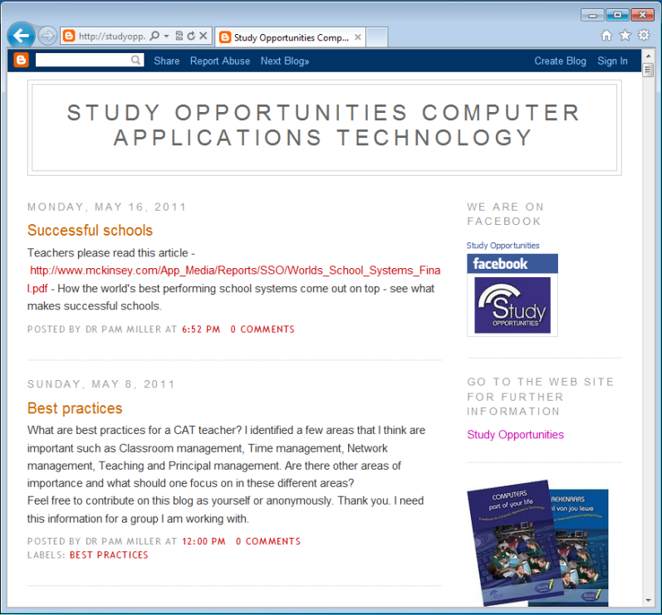
OTHER MODES OF E-COMMUNICATION
Weblog (blog)
Website updated regularly with news and events
Reads like a journal with most recent entry at the top
Not just personal – also used by businesses, citizen journalists, etc.

Slide 19

OTHER MODES OF E-COMMUNICATION
Fax to email
Ability to send/receive fax to/from a fax machine using computer and email system
Register with service provider that offers this service – will receive dedicated fax number
Free for incoming faxes, pay for faxes you send

Slide 20
ACTIVITY 2

Slide 21
NETIQUETTE
Netiquette and social networking
Use of good manners and showing respect for other users when using the internet
Think before you post …
Would I be happy if this were placed on a public poster?
Would I be happy for e.g. my parents or teacher to see this?
Is this the kind of information that reflects who I am?
Would I be happy for a prospective employer to see my site?

Slide 22
NETIQUETTE
Netiquette and email
Message must be clear and error-free
Never type messages only in capital letters
Files attached to a message must be viruses-free
Never be insulting in a message If you wish to tease someone, use an emoticon or emoji to show you are just teasing
;-)

Slide 23
NETIQUETTE
Netiquette and email
Use emoticons and emojis only in informal correspondence
Never pass on chain mail, hoaxes or spam
Large attachments – first contact recipient and agree on a suitable method
Be careful of passing on personal information via email

Slide 24
ACTIVITY 3

Slide 25
TEST AND IMPROVE
Summary – concepts, terms and tips
Email
ISP-based
Web-based
Other modes of electronic communication
Social networking sites
Netiquette
Social networking sites
Email
Format of email address
Address book or contacts list
Mailing list
Practical tips
Instant messaging, chat, SMS
Weblog (blog)
Fax to email

Slide 26
WRITTEN MODULE ACTIVITY

